Slide 1

Forecasting Method
SARIMA
Seasonal Autoregressive Integrated Moving Average

Slide 2
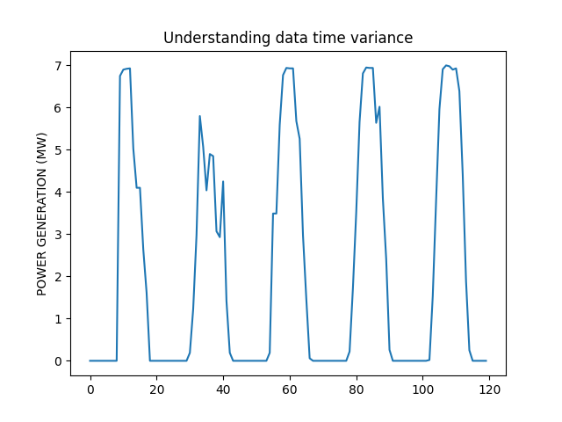
Why and How
ARIMA (An autoregressive integrated moving average) is a statistical analysis model that uses time series data to either better understand the data set or to predict future trends.
I have found out that SARIMA Works better with seasonality dataset.

Slide 3
Selected features
Forecasting parameter: POWER GENERATION
Used parameters: Date, Time
ARIMA parameters: p,d,q
External parameter of Cloudness

Slide 4
Explanation of code
INPUTS: Path name, Which day after the given data, Cloudness of that day
OUTPUTS: Power prediction of that day

Slide 5
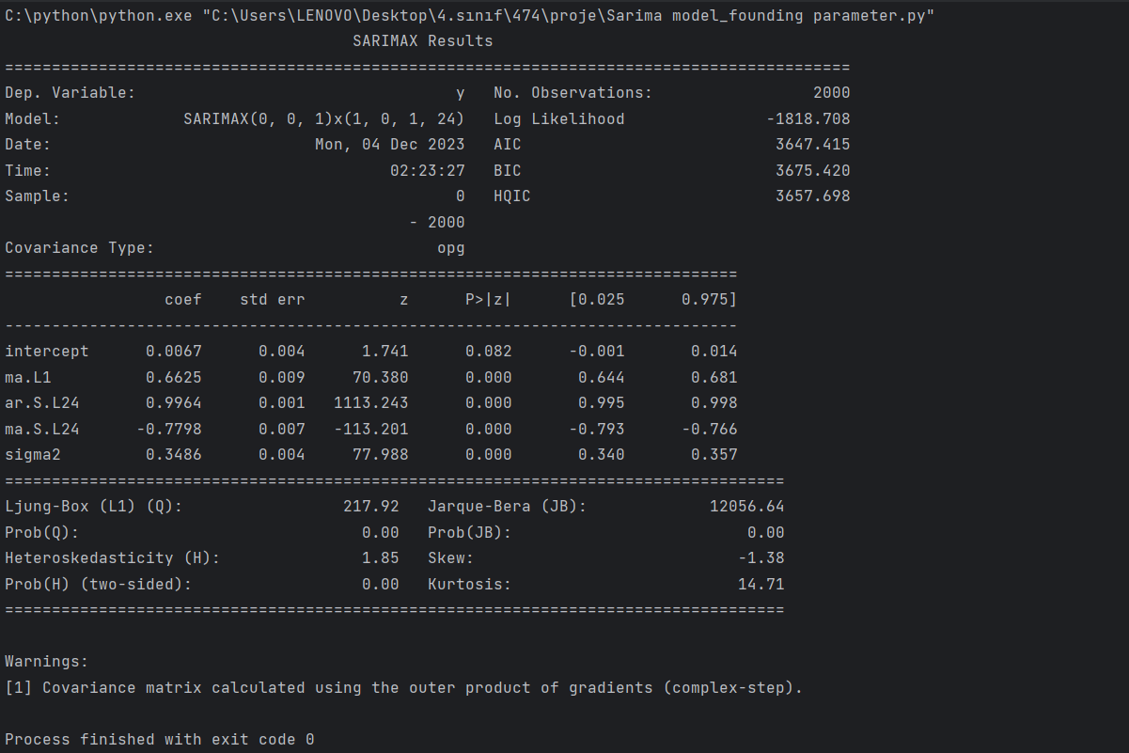
To find ARIMA parameters

Slide 6
Method to improve accuracy of method
Adding Cloudness parameter as an external factor
Taking as a input list of, given days Cloudness
Not goes into forecasting model

Slide 7
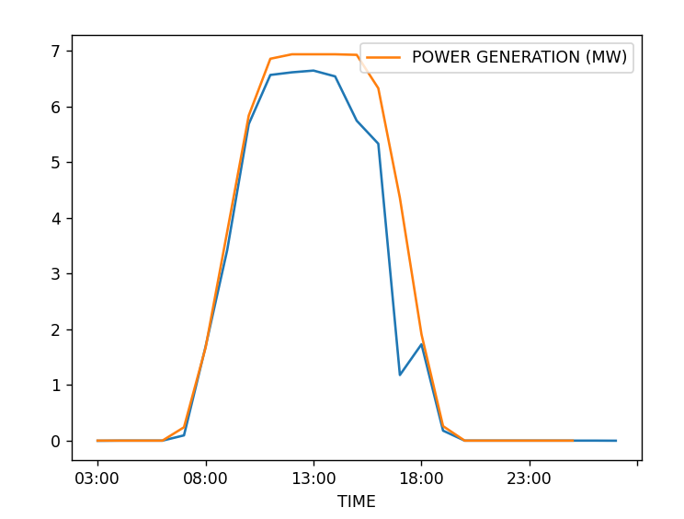
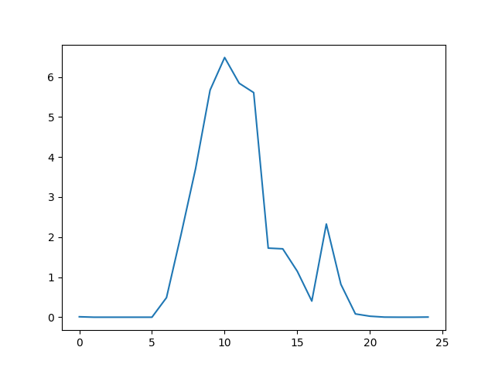
Test results
Prediction test of 06.09.2020
Next day prediction
Given Cloudness = [0,0,0,0,0,0,0,0,0,0,0,0,0,70,70,80,90,8,0,0,1,0,0,0,0]

Slide 8
ANY QUESTIONS? THANK YOU
ONUR TOPRAK

